Slide 1
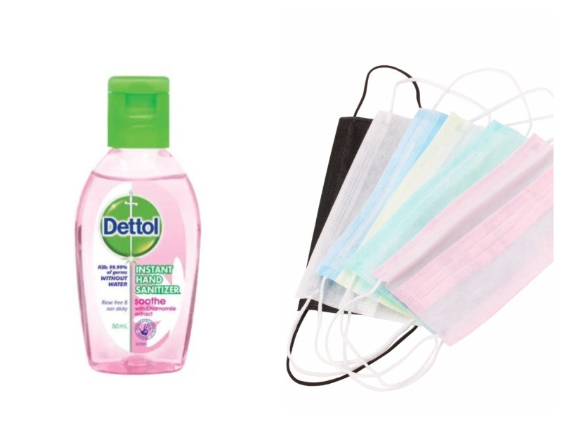
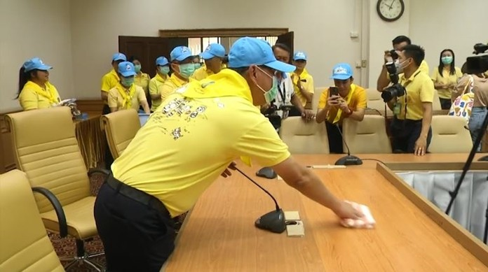
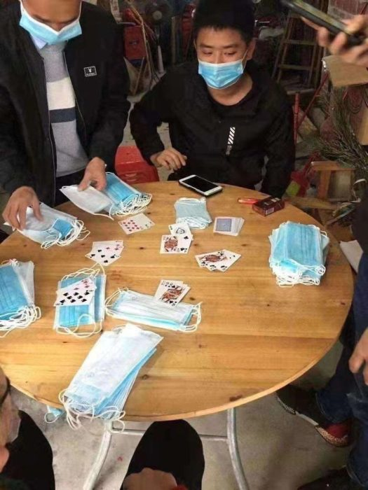
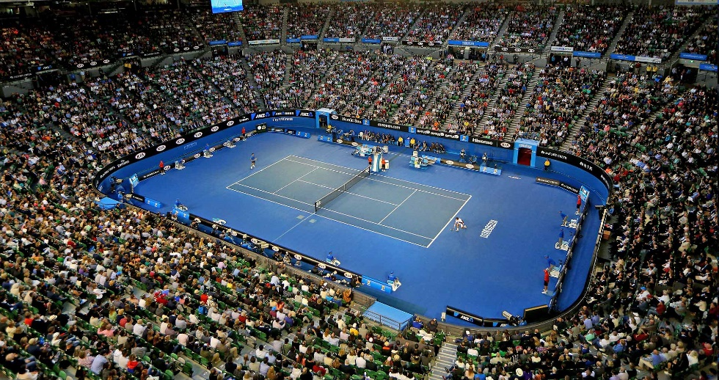
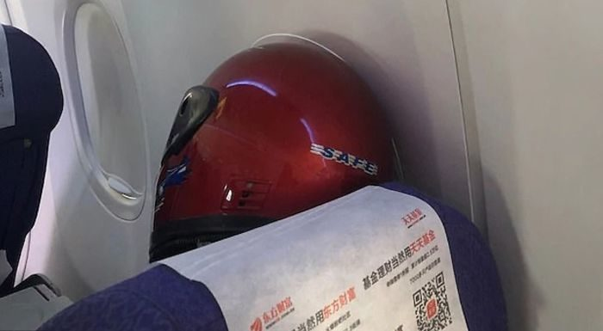
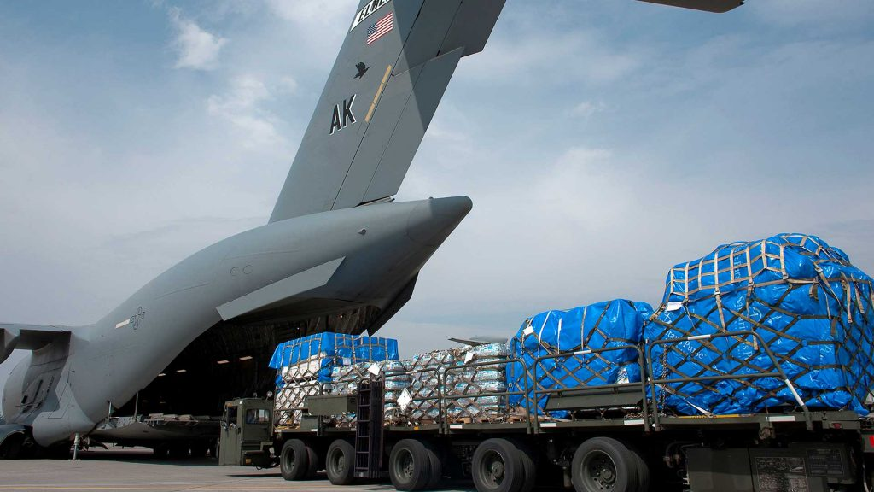
Conversation Class
Corona Virus
Christopher bAUMAN

Slide 2
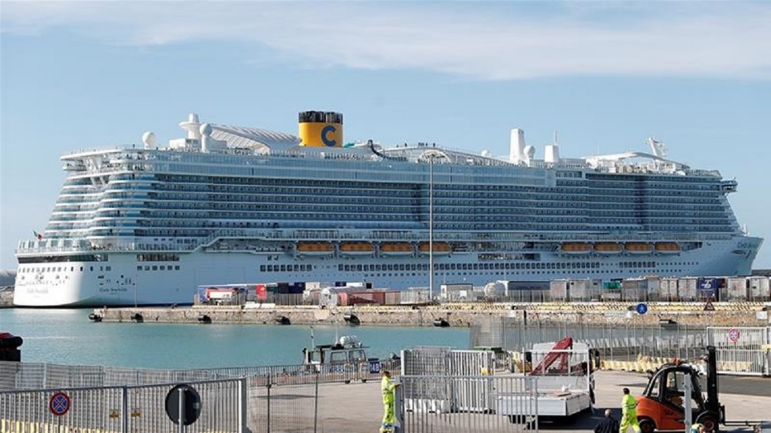
Education Infographic
1 mask 面具
2 fever 發燒
3 virus 病毒
4 acute 急性的
5 alcohol 酒精
6 infection 感染
7 severe 嚴重的
8 epidemic 瘟疫;傳染病
9 pharmacy 藥局
10 contagious 接觸傳染性的
11 emergency 緊急情況
12 temperature 溫度
13 symptom 症狀
14 quarantine 隔離；檢疫
15 thermometer 溫度計
16 Protect
17 epicenter
Teachers
Education
Skills
Chris Bauman

